Slide 1

بِسْمِؔ اللّٰہِ الرَّحْمٰنِ الرَّحِیْمِ
نَحْمَدُہٗ وَنُصَلِّیْ عَلٰی رَسُولِہِ الْکَرِیْم
MS in Project Management

Slide 2
Week 2
PROJECT, PROGRAM, PORTFOLIO, AND OPERATIONS MANAGEMENT
PROJECT LIFE CYCLE AND FEW OTHER COMPONENTS

Slide 3
Vision and Mission
A mission statement defines the organization's business, its objectives, and how it will reach these objectives.
A vision statement details where the organization aspires to go. Why does your company exist? What do you hope to accomplish in the next several years?

Slide 4
Vision and Strategic Objectives
A Vision statement describes Organization’s desired position for their business in future.
Where they want to be in future
Its all about Long term Goals

Slide 5
vision statements examples
PEPSICO
BE THE GLOBAL LEADER IN CONVENIENT FOODS AND BEVERAGES BY WINNING WITH PURPOSE
MEEZAN bANK
Establish Islamic banking as banking of first choice

Slide 6
Examples of Strategic Objectives
Enter new markets
Create and launch new product
Company’s sales growth
Gain market position
Return on Assets/Investment
Shareholders dividend
KPIs examples for ‘Enter new Market’
Enter X, Y, Z markets by Date
20 total regional markets by date.
20% market share in each new market.

Slide 7
The Relationships among Portfolios, Programs, and Projects
Programs:
  Refers to group of Projects or Subprojects
Portfolio:
  Collection of Programs, Projects, sub portfolios
Organizational planning impacts the projects by means of project prioritization based on risk, funding and other considerations
PMI, PMP, PMBOK and the PMI Registered Education Provider logo are registered marks of the Project Management Institute, Inc.
© All rights reserved
www.3foldtraining.com
7

Slide 8
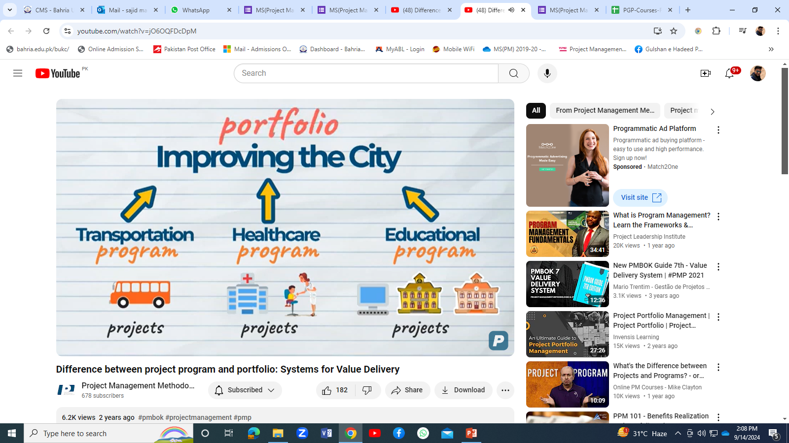

Slide 9
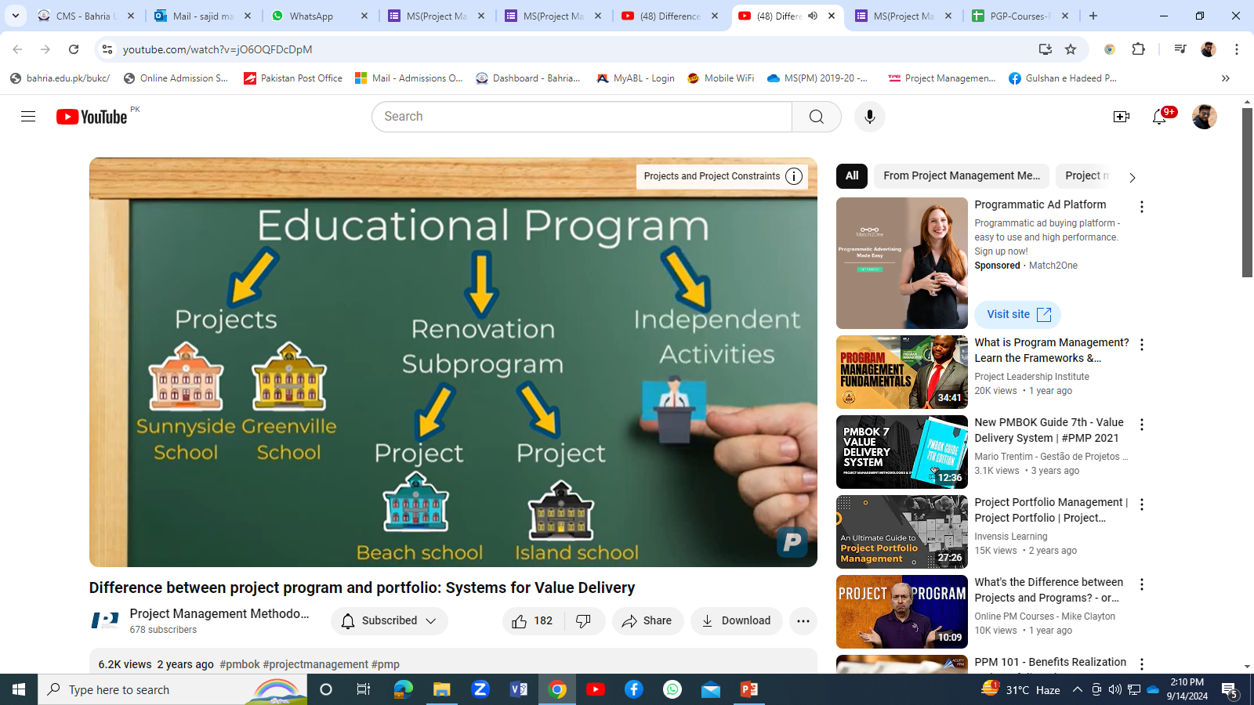

Slide 10
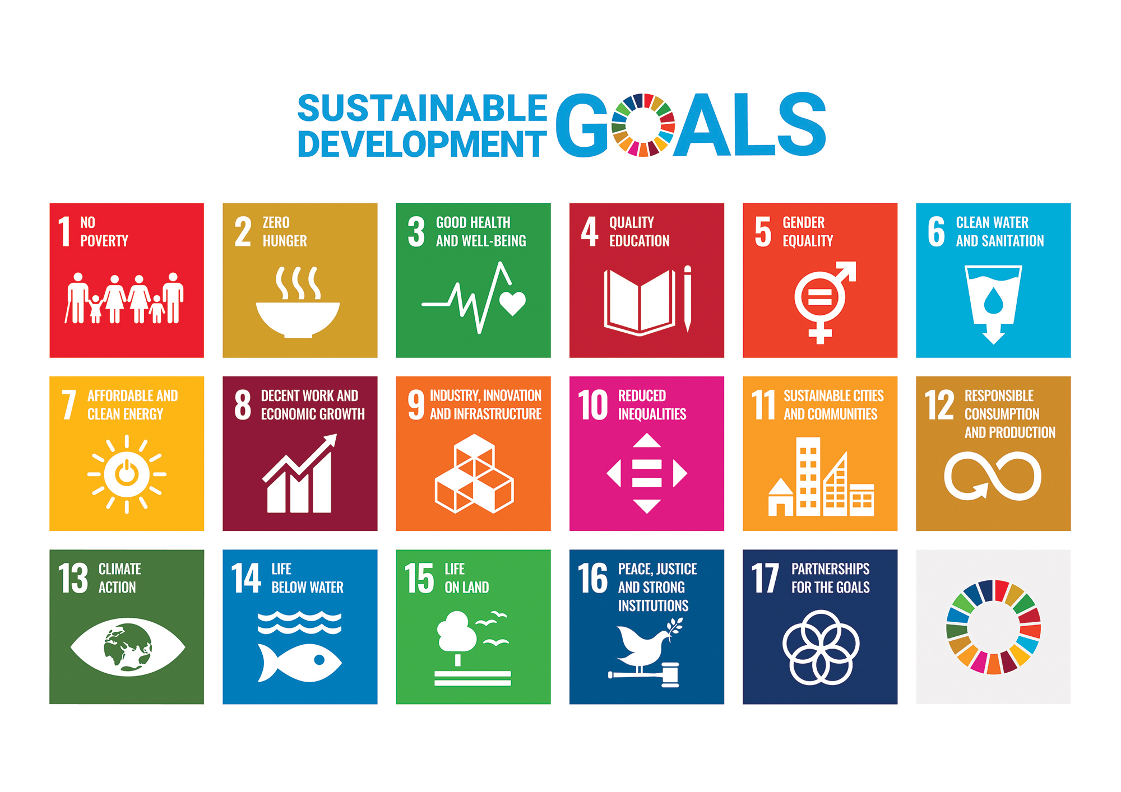

Slide 11
Portfolio Management
A portfolio can be generally described as a group of program , projects, sub portfolios grouped together to achieve specific strategic business goal.
They may not be related to each other
Only reason for grouping them together is to achieve that business goal
A portfolio describes the collection of investment in the form of projects and programs in which the organization invests the capital
PMI, PMP, PMBOK and the PMI Registered Education Provider logo are registered marks of the Project Management Institute, Inc.
© All rights reserved
11

Slide 12
Program Management
Program is a group of related projects, subprograms.
Projects in a program are managed in a coordinated way to maximize the benefits which will not be available if managed individually.
Some work in the programs might not fall under any discrete projects, but it might be necessary to complete the program successfully.
Program management manages the project interdependencies and help resolve resource constraints, issues, conflicts, etc., To achieve program’s strategic objectives.
Managing Program risks, change requests, budget, benefits realization
12

Slide 13
Program Management
A example of program would be a new communication
satellite system
Under this program there are projects such as project for design of satellite , project for constructing ground stations, project for integration of system, and project to launch satellite.
Each project under the program has its own goals and objectives that are in alignment with the mission of installing new communication satellite system
PMI, PMP, PMBOK and the PMI Registered Education Provider logo are registered marks of the Project Management Institute, Inc.
© All rights reserved
13

Slide 14
Program and project management focus on doing programs and projects the “right” way; and
Portfolio management focuses on doing the “right” programs and projects.

Slide 15
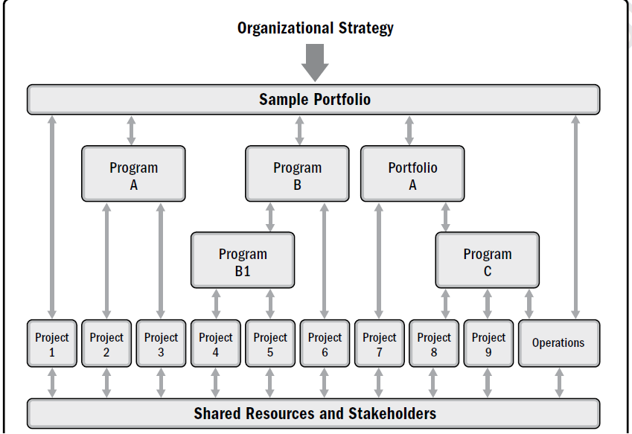

Slide 16
Operations & Project Management
Operations Management manages ongoing production of goods and or services
Projects can intersect with operations at various points
During closeout phase
When developing a new product, upgrading a product, etc
This interaction mainly includes knowledge transfer from Project team to operation team.
PMI, PMP, PMBOK and the PMI Registered Education Provider logo are registered marks of the Project Management Institute, Inc.
© All rights reserved
www.3foldtraining.com
16

Slide 17
Relationship Among Portfolio Management, Program Management, and organizational Project Management
Organizational Project Management (OPM):
“ OPM is strategy execution framework utilizing project, program, and portfolio management as well as organizational enabling practices to consistently and predictably deliver organizational strategy producing better performance, better results, and sustainable competitive advantage”
17

Slide 18
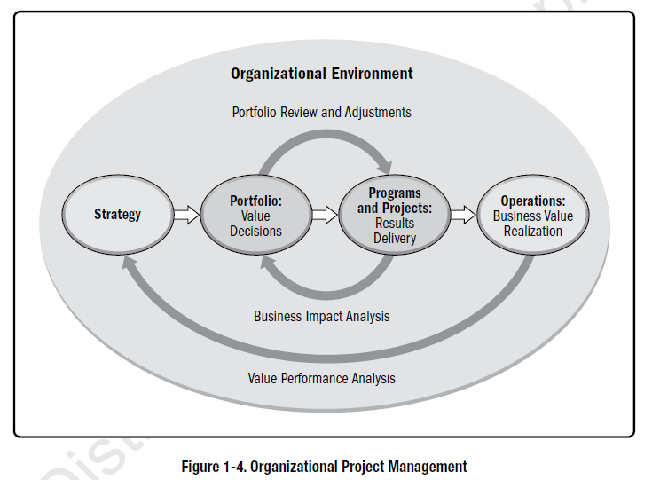

Slide 19
Group Activity
Imagine you are the Minister of Education responsible for managing the education portfolio. Propose several programs and projects to help achieve the government's vision of increasing the literacy rate to 90% by 2030
19

Slide 20
Project Life cycle and other Components
Project Life Cycle:
  The series of phases that a project passes through from its start to its completion.
  The project life cycle can be determined or shaped by the unique aspects of the organization, industry, or technology employed.
  Project Life cycle usually includes product development cycle
PMI, PMP, PMBOK and the PMI Registered Education Provider logo are registered marks of the Project Management Institute, Inc.
© All rights reserved
www.3foldtraining.com
20

Slide 21
Project phase
A project phase is a collection of logically related project activities that culminates in the completion of one or more deliverables.
The phase structure allows the project to be segmented into logical subsets for ease of management, planning and control.

Slide 22
All projects can be mapped to the following generic life cycle structure:
  • Starting the project,
  • Organizing and preparing,
  • Carrying out the project work, and
  • Closing the project

Slide 23
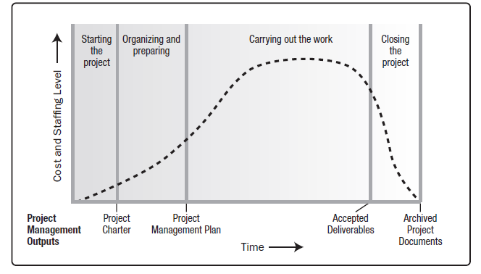
A generic Project life cycle structure

Slide 24
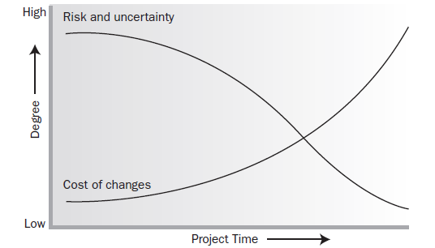
Impact of Variable Based on Project Time

Slide 25
  What is your project’s life cycle? How are you dividing your project phases?

Slide 26
Regardless of the number of phases comprising a project, all phases have similar characteristics:
The work has a distinct focus that differs from any other phase.
Achieving the primary deliverable or objective of the phase requires controls or processes unique to the phase or its activities.
The closure of a phase ends with some form of transfer or hand-off of the work product produced as the phase deliverable.

Slide 27
Phase-to-Phase Relationships
Sequential relationship
In a sequential process, a downstream phase (eg construction) starts when an upstream one (eg design) ends.
Overlapping or concurrent process
Here a downstream phase starts before an upstream one is completed. While this approach provides opportunities to compress the time taken to complete the schedule, it may increase uncertainty

Slide 28
Project Life Cycle
Predictive Life Cycle:
  In a predictive life cycle, the project scope, time, and cost are determined in the early phases of the life cycle. Any changes to the scope are carefully managed e.g general construction projects.
PMI, PMP, PMBOK and the PMI Registered Education Provider logo are registered marks of the Project Management Institute, Inc.
© All rights reserved
www.3foldtraining.com
28

Slide 29
Iterative Life Cycle:
  In an iterative life cycle, the project scope is generally determined early in the project life cycle, but time
  and cost estimates are routinely modified as the project team’s understanding of the product increases. Iterations develop the product through a series of repeated cycles, while increments successively add to the functionality of the product. e.g. Large and complex projects.
PMI, PMP, PMBOK and the PMI Registered Education Provider logo are registered marks of the Project Management Institute, Inc.
© All rights reserved
www.3foldtraining.com
29

Slide 30
Adaptive Life Cycle:
  Adaptive life cycles are agile, iterative, or incremental. The detailed scope is defined and approved before the start of an iteration. Adaptive life cycles are also referred to as agile or change-driven life cycles. It is associated with ‘agile methodologies’ and is often used for novel, uncertain and fast-changing environments such as research and new product development..
PMI, PMP, PMBOK and the PMI Registered Education Provider logo are registered marks of the Project Management Institute, Inc.
© All rights reserved
www.3foldtraining.com
30

Slide 31
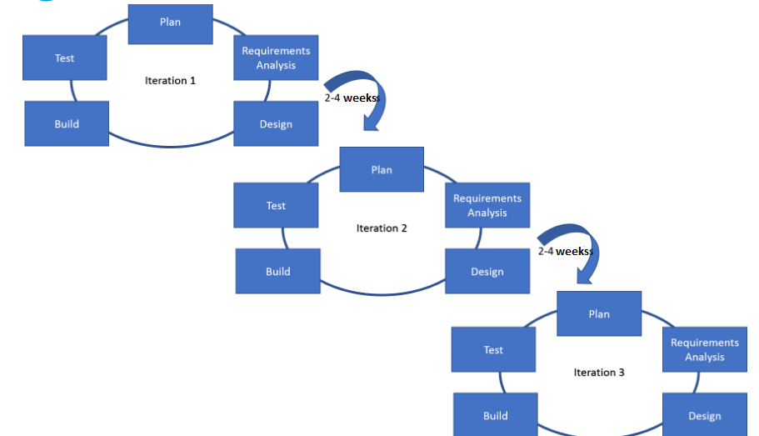

Slide 32
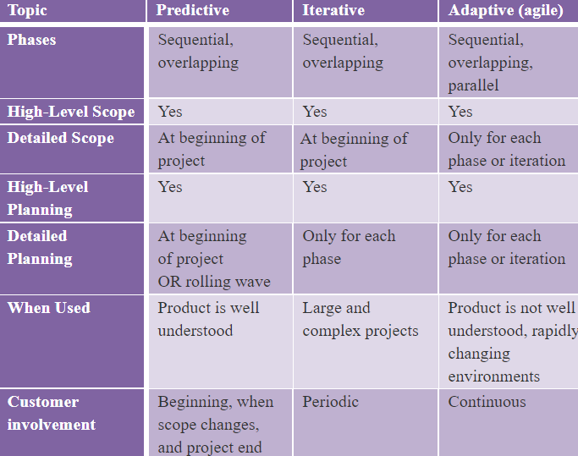

Slide 33
PHASE GATE
A phase gate, is held at the end of a phase. The project’s performance is reviewed.
A decision (e.g., go/no-go decision) is made as a result of this comparison to:
Continue to the next phase,
Continue to the next phase with modification,
End the project,
Remain in the phase, or
Repeat the phase or elements of it
PMI, PMP, PMBOK and the PMI Registered Education Provider logo are registered marks of the Project Management Institute, Inc.
© All rights reserved
www.3foldtraining.com
33

Slide 34
PROJECT MANAGEMENT PROCESSES
The project life cycle is managed by executing a series of project management activities known as project management processes.
Every project management process produces one or more outputs from one or more inputs by using appropriate project management tools and techniques
Examples Define Scope, Develop Project Charter etc.

Slide 35
THE END

